Slide 1

SSE vs Web-sockets for unidirectional data flow over HTTP/2
by Martin Chaov

Slide 2

Hi, I’m Martin!
Tech enthusiast
Software architect
Ex-designer
...at least for me...

Slide 3
TOPICS

Slide 4
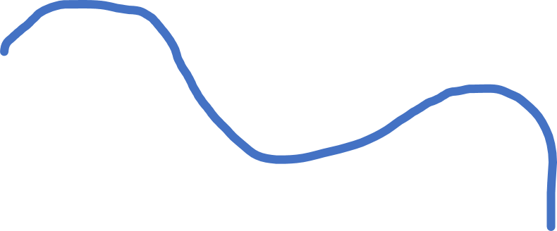
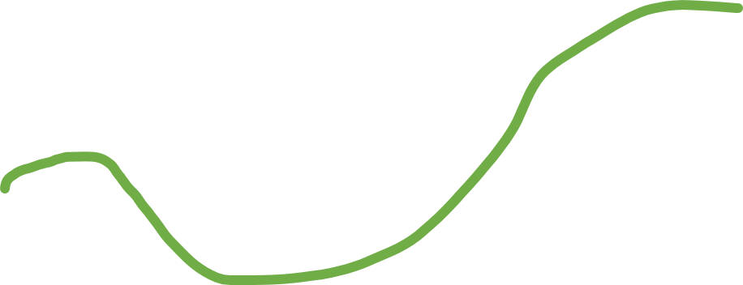
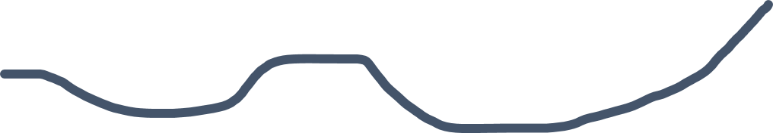

TOPICS
Business Case
Long-polling
Web-sockets
SSE

Slide 5
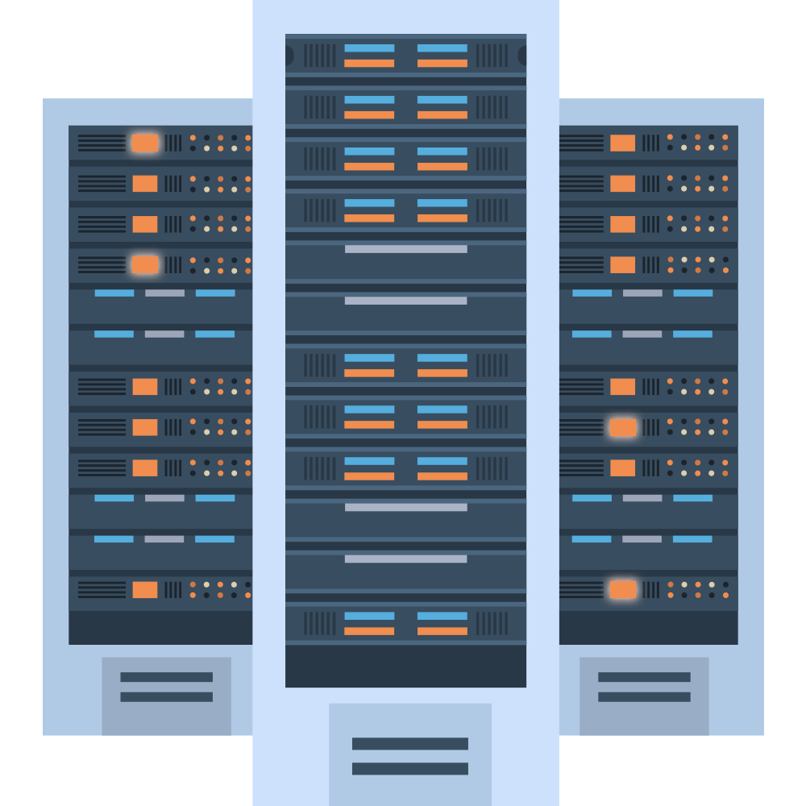

THE BUSINESS CASE

Slide 6
Notes:
HTTP/2
Multiplexing
Traffic efficient

Slide 7

Notes:
What are our options?
Polling
Sockets
SSE

Slide 8

TRY ALL
THE THINGS

Slide 9
LONG POLLING
Notes:
In short:
Client ask the server for data. Server has no data and waits for some amount of time.
- If something pops up during the wait, server sends it and closes request.
- If there is nothing to send and the maximum wait time is achieved, server sent response that there is not data.
- In both cases client opens the next request for data.
- Lather, rinse, repeat
Annoying “are we there” child on the back seat of your car.

Slide 10
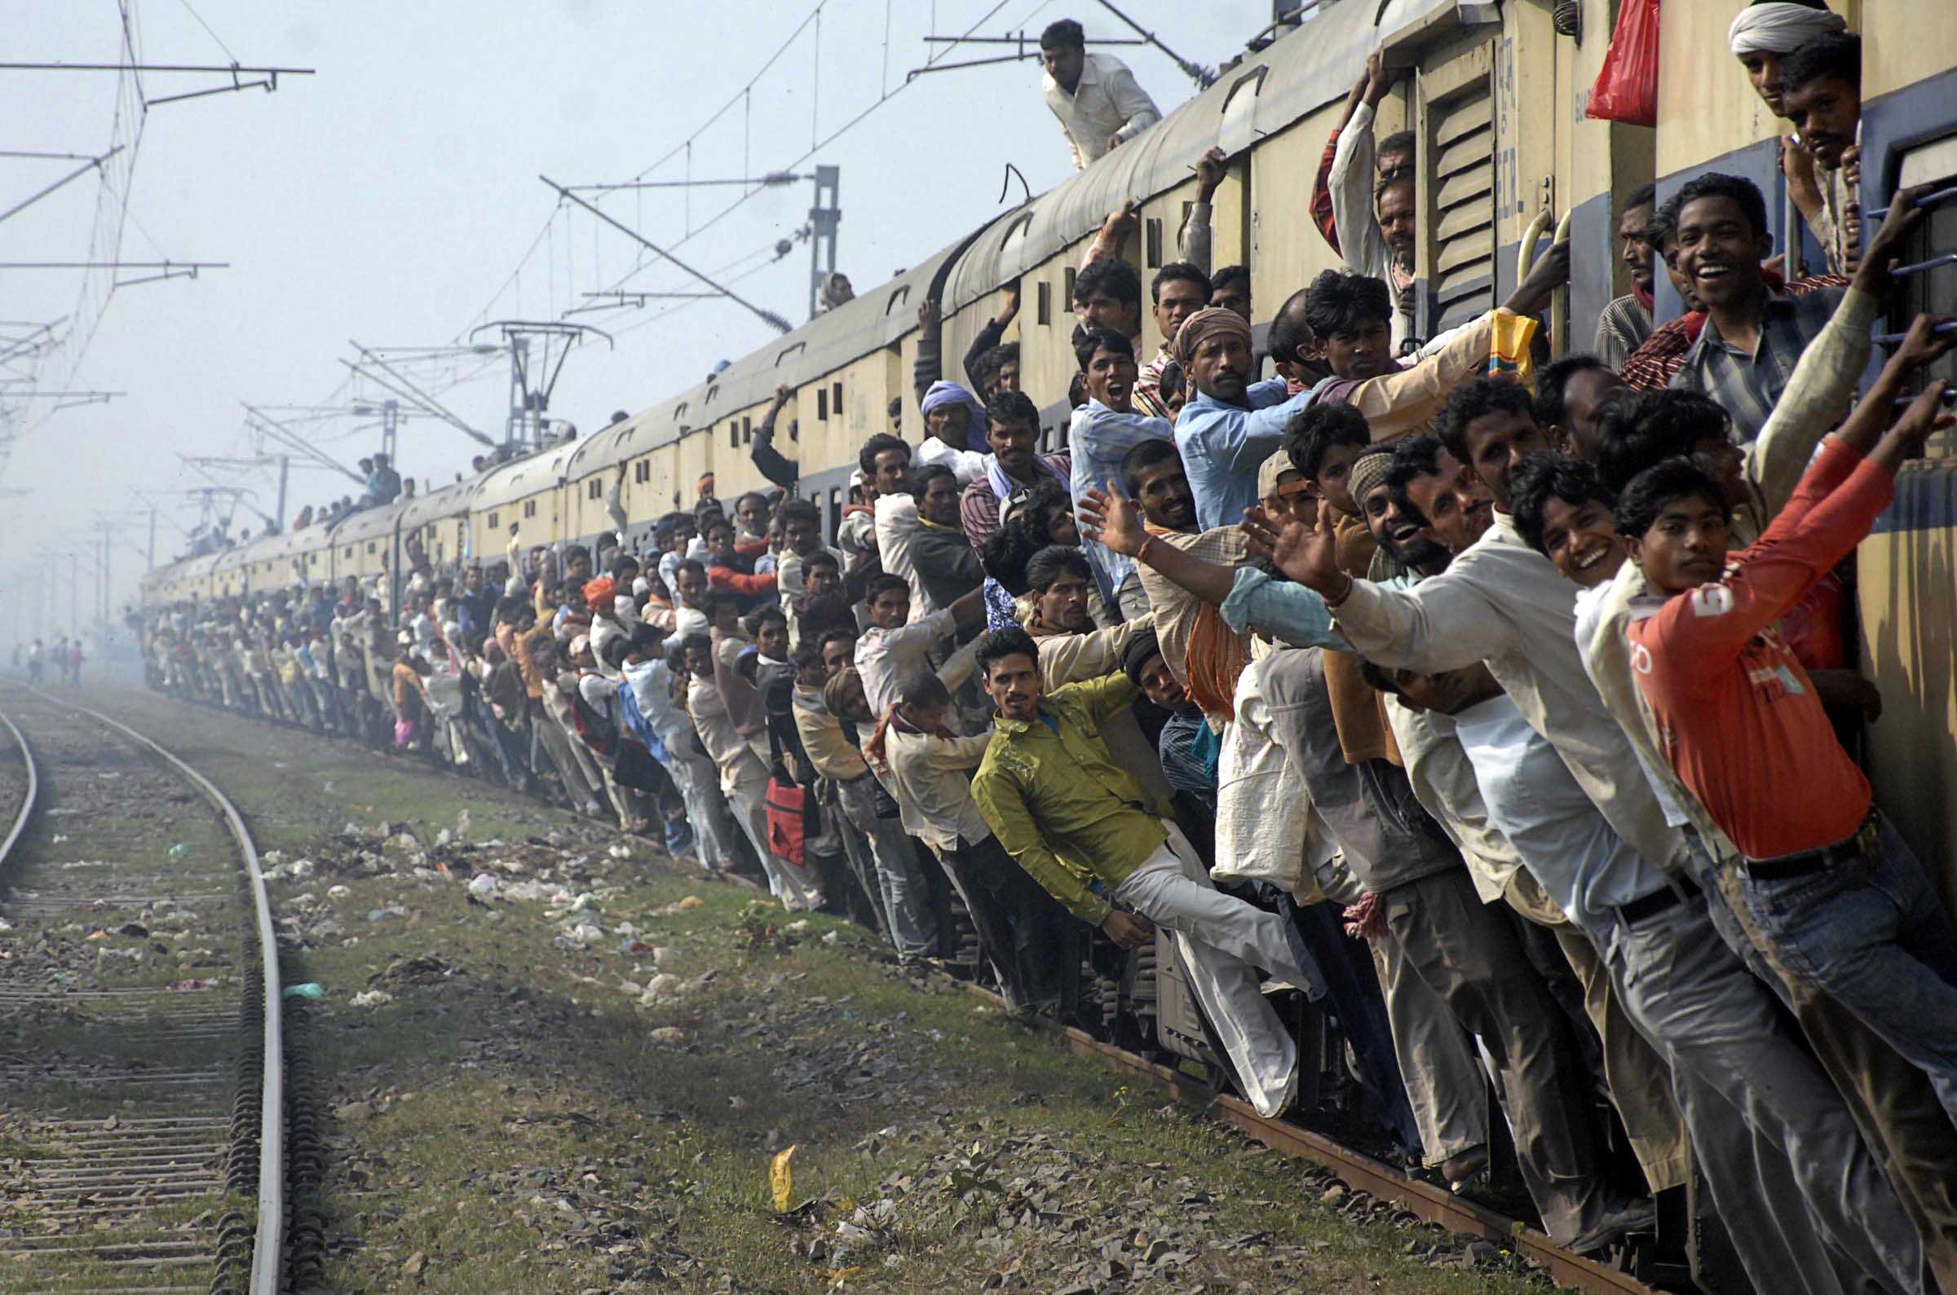
HEADER OVERHEAD
Notes:
Complete message
All headers
Useless traffic
- Header overhead: Every long poll request and long poll response is a complete HTTP message and thus contains a full set of HTTP headers in the message framing. For small, infrequent messages, the headers can represent a large percentage of the data transmitted. For fast small messages this introduces overhead in terms of data transfer. The actual useful payload is much less than the total transmitted bytes. Example: 15 KB of headers for 5 KB of data...

Slide 11

MAXIMAL LATENCY
Notes:
Delayed data
Network transits
Packet loss
Retransmission
- Maximal latency: After a response, the server needs to wait for the next request before another message can be sent to the client. While the average latency for long polling is close to one network transit, the maximum latency is over three network transits - response, request, response. However due to packet loss and retransmission maximum latency for any TCP/IP protocol will be more than three network transits (avoidable with HTTP pipelining).

Slide 12
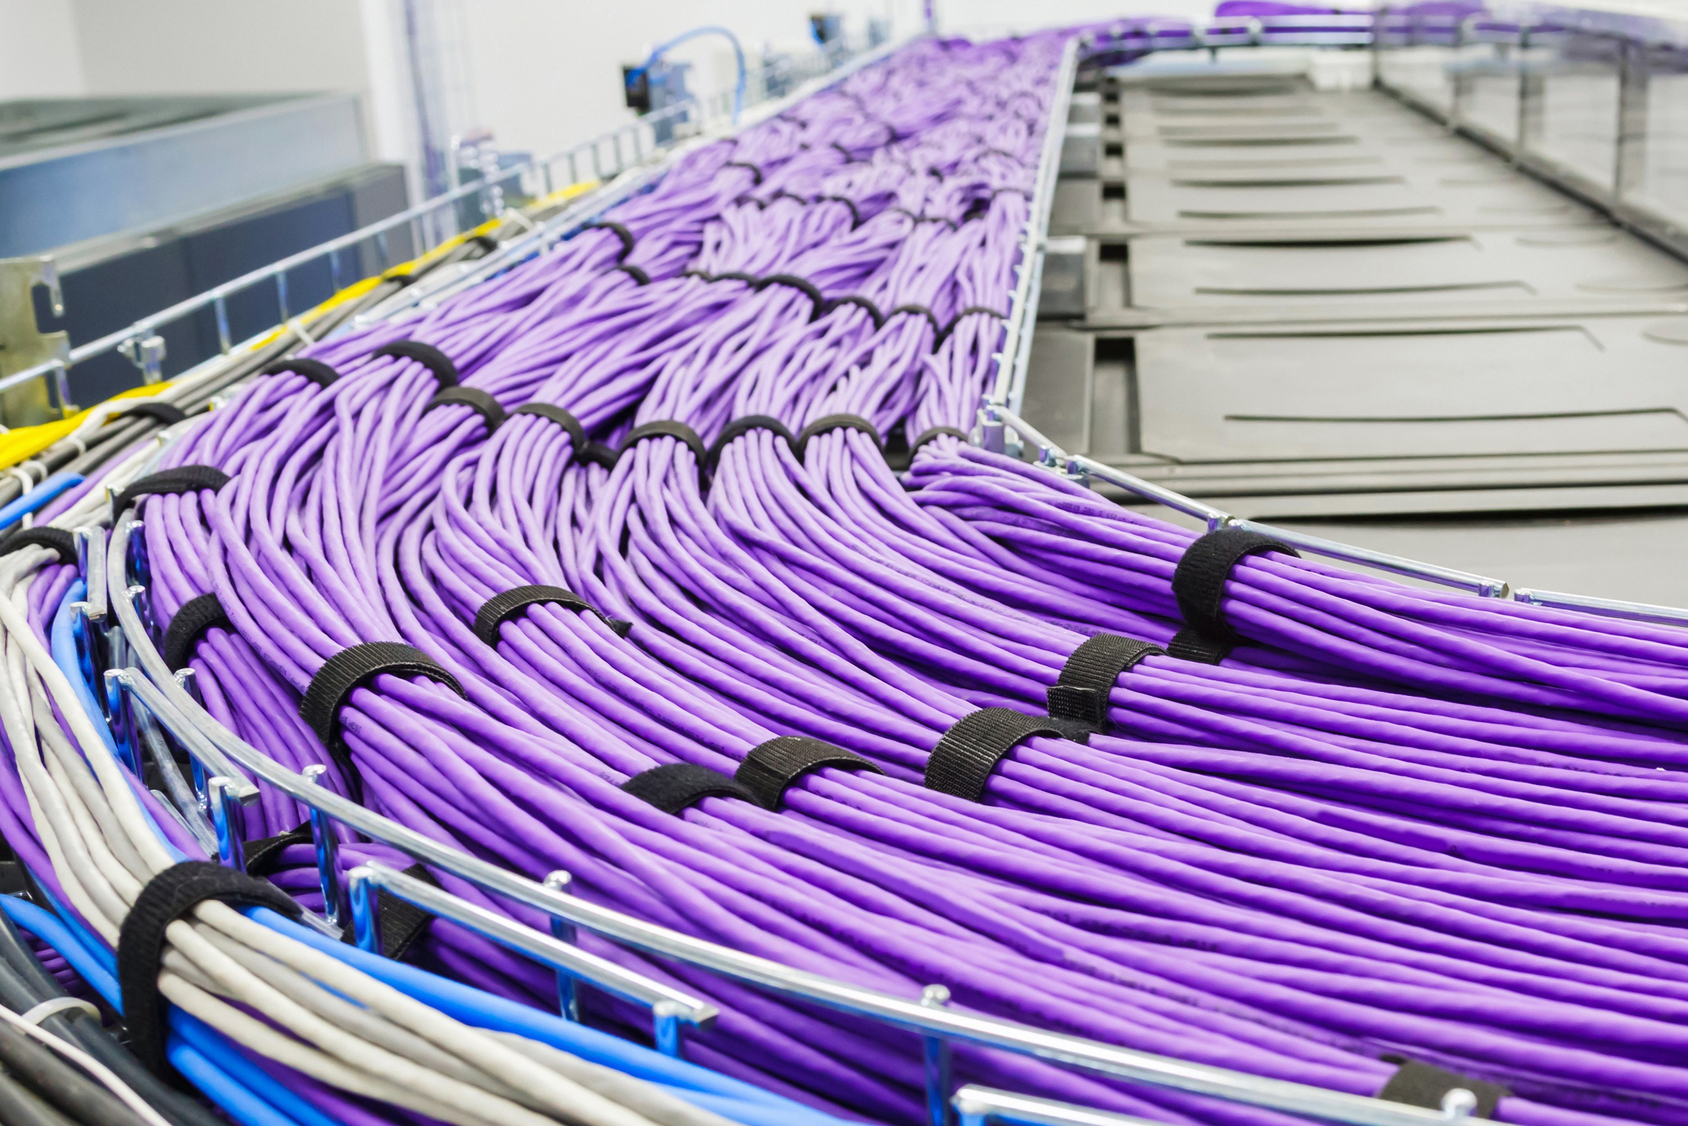
CONNECTION ESTABLISHMENT
Notes:
Time to establish connection
- Connection establishment: although it can be avoided by using with persistent HTTP connection reusable for many poll requests it is tricky to time accordingly all your components to poll in short timed durations to keep the connection alive. Eventually depending on the server responses your polls will get desynchronized.

Slide 13

PERFORMANCE DEGRADATION
Notes:
Stack messages
Overflow the queue
- A long polling client (or server) that is under load has a natural tendency to degrade in performance at the cost of message latency. When that happens, events that are pushed to the client will queue. This really depends on the implementation; in our case, we need to aggregate all the data as we are sending add/remove/update events to our widgets.

Slide 14
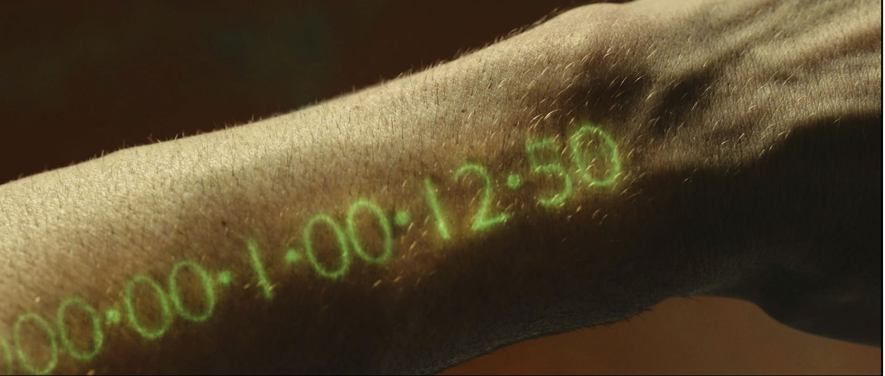
TIMEOUT
Notes:
Proxies
Timeouts
- Timeouts: Long poll requests need to remain pending or "hanging" until the server has something to send to the client. This can lead into the connection getting closed by the proxy server if being idle for too long.

Slide 15
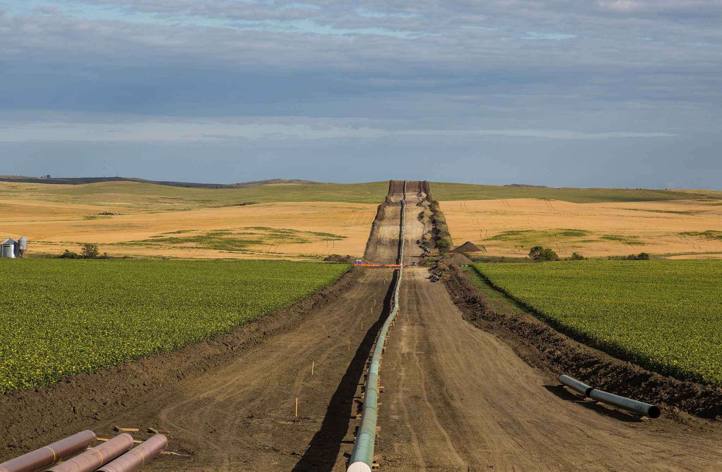
MULTIPLEXING
Notes:
- Multiplexing: can happen if the responses happen at the same time over persistent HTTP/2 connection. Tricky to do as polling responses can't really be in sync.

Slide 16
WEB-SOCKETS
Notes:
*Via MDN:*
>"WebSockets is an advanced technology that makes it possible to open an interactive communication session between the user's browser and a server. With this API, you can send messages to a server and receive event-driven responses without having to poll the server for a reply."
This is a communications protocol providing full-duplex communication channels over a single TCP connection.
Both are located at the application layer from the OSI model and as such depend on TCP at layer 4.
7. Application
6. Presentation
5. Session
4. Transport
3. Network
2. Data link
1. Physical
RFC 6455 states that WebSocket "is designed to work over HTTP ports 80 and 443 as well as to support HTTP proxies and intermediaries" thus making it compatible with the HTTP protocol. To achieve compatibility, the WebSocket handshake uses the HTTP Upgrade header to change from the HTTP protocol to the WebSocket protocol.
There is a very good Wikipedia article on web-sockets. I encourage you to read it.

Slide 17

PROXYES
&
FIREWALLS
Notes:
Proxies & Radius proxies
Blocked ports
Firewalls
- Proxy servers: On general there are few different issues with web sockets and proxies. First one is related to internet service providers and the way they handle their networks. Issues with radius proxies, blocked ports and so on... Second type of issues is related to the way the proxy is configured to handle the unsecured HTTP traffic and long lived connections (impact is lessened with HTTPS). Third: "With WebSockets you are forced to run TCP proxies as opposed to HTTP proxies. TCP proxies can not inject headers, rewrite URLs or perform many of the roles we traditionally let our HTTP proxies take care of."

Slide 18
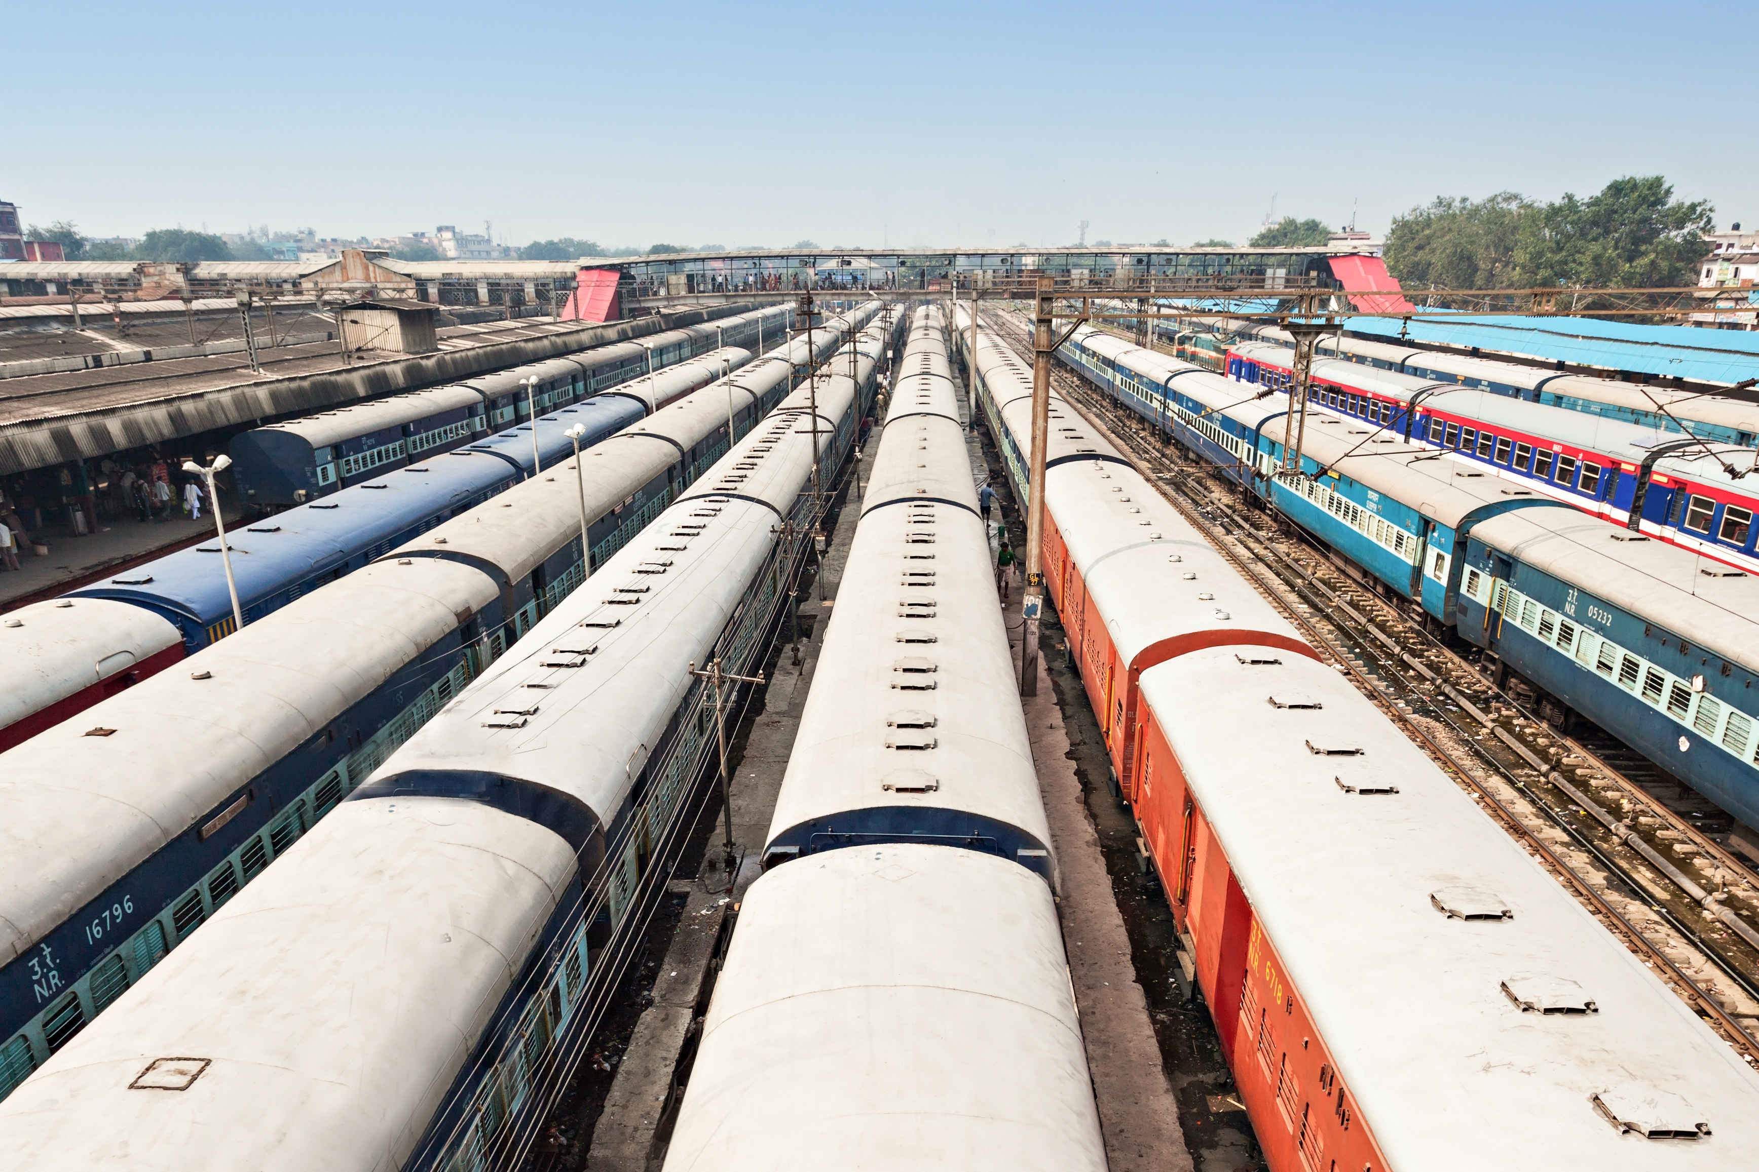
# OF CONNECTIONS
Notes:
No connection limit
10 sockets * 5 tabs = 50
No multiplexing
Custom multiplexer
- Number of connections: The famous connection limit for HTTP requests that revolves around the number 6, doesn't apply to web sockets. 50 sockets = 50 connections. Ten browser tabs by 50 sockets = 500
connections and so on. Since web socket is a different protocol for delivering data it's not automatically multiplexed over HTTP/2 connections. Implementing custom multiplexing both on the server and the client is too complicated to make sockets useful in the specified business case.

Slide 19

LOAD
BALANCING
Notes:
Moving users around servers
Reconnecting sockets over MS infra
Closed and re-opened
- Load balancing: If every single user opens N number of sockets, proper load balancing is very complicated. When your servers get overloaded and you need to create new instances and terminated old ones depending on the implementation of your software the actions that are taken on "reconnect" can trigger a massive chain of refreshes and new requests for data that will overload your system. Web sockets needs to be maintained both on the server and on the client. It's not possible to move socket connections to different server if the current one experiences high load. They must be closed and reopened.

Slide 20

REINVENTING THE WHEEL
Notes:
Compression of data
Multiplexing
- Reinventing the wheel: With web sockets one must handle lot's of problems that are taken care of in HTTP on their own.

Slide 21

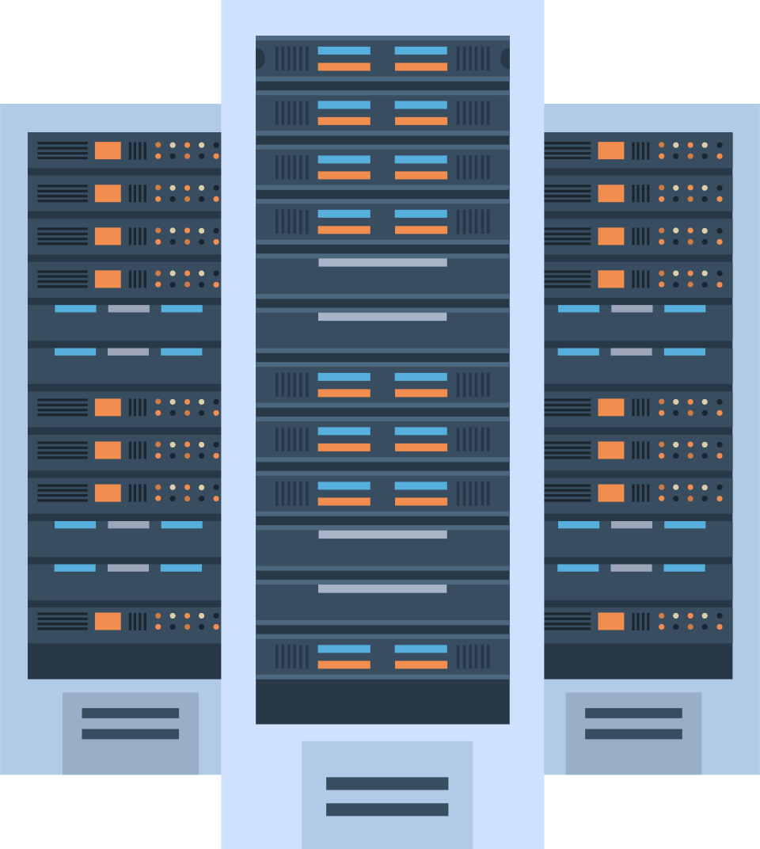

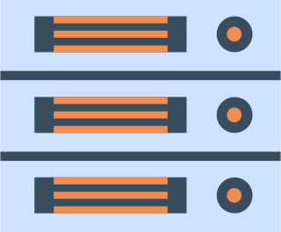


Notes:
With both approaches (web sockets and long polling) for delivering updates to the client we get the same issue over mobile devices and networks. Because of the hardware design of these devices keeping an open connection means keeping the antenna and connection to the cellular network alive. This leads to reduced battery life, heat, and in some cases, extra charges for data.
We also get increased operational overhead in terms of developing, testing, and scaling; the software and it's IT infrastructure.

Slide 22
Notes:
With both approaches (web sockets and long polling) for delivering updates to the client we get the same issue over mobile devices and networks. Because of the hardware design of these devices keeping an open connection means keeping the antenna and connection to the cellular network alive. This leads to reduced battery life, heat, and in some cases, extra charges for data.
We also get increased operational overhead in terms of developing, testing, and scaling; the software and it's IT infrastructure.

Slide 23
SSE
Notes:
*Via MDN:*
>"The EventSource interface is used to receive server-sent events. It connects to a server over HTTP and receives events in text/event-stream format without closing the connection."
Main difference to Long polling is that we get only one connection and keep an event stream going through it. Long polling creates a new connection for every poll - ergo the headers overhead.
Server-Sent Events are real-time events emitted by the server and received by the browser. They’re similar to WebSockets in that they happen in real time, but they’re very much a one-way communication method from the server.
### Unique features
- The connection stream is from the server and read-only.
- They use regular HTTP requests for the persistent connection, not a special protocol.
- If the connection drops, the EventSource fires an error event and automatically tries to reconnect. The server can also control the timeout before the client tries to reconnect.
- Clients can send a unique ID with messages. When a client tries to reconnect after a dropped connection, it will send the last known ID. Then the server can see that the client missed ```n``` messages and send the backlog of missed messages on reconnect.

Slide 24
// Client side implementation
// subscribe for messages
var source = new EventSource(‘URL’);
// handle messages
source.onmessage = function(event) {
// Do something with the data:
event.data;
};
Notes:
What we see from the example is that the client side is fairly simple. Connect to our source and wait to receive messages.
To enable servers to push data to Web pages over HTTP or using dedicated server-push protocols, the specification introduces the ```EventSource``` interface on client.
Using this API consists of creating an ```EventSource``` object and registering an event listener.
_NOTE: client implementation for web-sockets looks very similar to this. Complexity with sockets lies in the IT infrastructure and server implementation._

Slide 25
// Handle build-in events
source.onopen
source.onmessage
source.onclose
// Handle custom events
source.addEventListenet("customEvent", handler);
Notes:
Each ```EventSource``` object has the following members:
- URL - set during construction.
- Request - initially is null.
- Reconnection time - value in ms. User-agent-defined value.
- Last event ID - initially an empty string.
- Ready state - state of the connection
- CONNECTING (0)
- OPEN (1)
- CLOSED (2)
Apart from the URL all are treated like private and cannot be accessed from outside.
Build-in events:
1. Open
1. Message
1. Error

Slide 26
// Server implementation
function handler(response)
{
response.writeHead(200, {
'Content-Type': 'text/event-stream’,
'Cache-Control': 'no-cache’,
'Connection': 'keep-alive’
});
response.write('id: UniqueID\n’);
response.write("data: " + data + '\n\n');
}
Notes:
Well if the client is that simple, maybe the server implementation is complex?
Server handler for SSE may look like this:
We define a function that is going to handle the response: 1. Setup headers
2. Create message
3. Send
Not that you don't see a ```send()``` or ```push()``` method call. This is because the standard defines that the message is going to be sent as soon as it receive two ```\n\n``` characters as in the example: ```response.write("data: " + data + '\n\n');```. This will immediately push the message to the client.

Slide 27
// SERVER
response.write('id: UniqueID\n');
response.write('event: add\n');
response.write('retry: 10000\n');
response.write("data: " + data + '\n\n’);
// CLIENT
source.addEventListener("add", function(event) {
// do stuff with data
event.data;
});
Notes:
As said before message can contain few properties:
1. Id - If the field value does not contain U+0000 NULL, then set the last event ID buffer to the field value. Otherwise, ignore the field.
2. Data - Append the field value to the data buffer, then append a single U+000A LINE FEED (LF) character to the data buffer.
3. Event - Set the event type buffer to field value.
4. Retry - If the field value consists of only ASCII digits, then interpret the field value as an integer in base ten, and set the event stream's reconnection time to that integer. Otherwise, ignore the field.
Anything else will be ignored. We can't introduce our own fields.
Example with added custom ```event```:

Slide 28
...
id: 54
event: add
data: "[{SOME JSON DATA}]"
id: 55
event: remove
data: JSON.stringify(some_data)
id: 56
event: remove
data: {
data: "msg" : "alternate JSON"\n
data: "field": "value"\n
data: "field2": "value2"\n
data: }\n\n
...
Notes:
You can send multiple messages separated by a new line as long as you provide different IDs.
This vastly simplifies what we can do with our data.

Slide 29

Notes:
The backend has some specifics that needs to be addressed to have a working implementation of SSE. Best case scenario you will be using event loop based server like NodeJS, Kestrel or Twisted. Idea being that with thread based solution you will have thread per connection => 1000 connections = 1000 threads. With event loop solution you will have 1 thread for 1000 connections.
1. You can only accept EventSource requests if the HTTP request says it can accept the event-stream MIME type.
2. You need to maintain a list of all the connected users in order to emit new events.
3. You should listen for dropped connections and remove them from the list of connected users.
4. You should optionally maintain a history of messages so that reconnecting clients can catch up on missed messages.

Slide 30
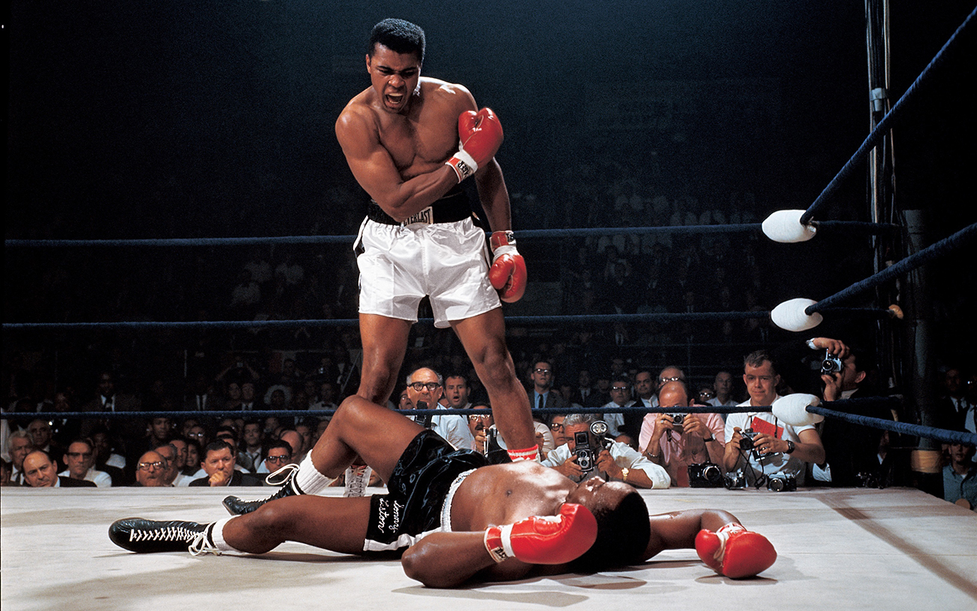
THE DEVIL
IS IN THE
DETAILS
Notes:
- Legacy proxy servers are known to, in certain cases, drop HTTP connections after a short timeout. To protect against such proxy servers, authors can include a comment line (one starting with a ':' character) every 15 seconds or so.
- Authors wishing to relate event source connections to each other or to specific documents previously served might find that relying on IP addresses doesn't work, as individual clients can have multiple IP addresses (due to having multiple proxy servers) and individual IP addresses can have multiple clients (due to sharing a proxy server). It is better to include a unique identifier in the document when it is served and then pass that identifier as part of the URL when the connection is established.
- Authors are also cautioned that HTTP chunking can have unexpected negative effects on the reliability of this protocol, in particular if the chunking is done by a different layer unaware of the timing requirements. If this is a problem, chunking can be disabled for serving event streams.
- Clients that support HTTP's per-server connection limitation might run into trouble when opening multiple pages from a site if each page has an EventSource to the same domain. Authors can avoid this using the relatively complex mechanism of using unique domain names per connection, or by allowing the user to enable or disable the EventSource functionality on a per-page basis, or by sharing a single EventSource object using a shared worker.
- Browser support

Slide 31
Notes:
With both approaches (web sockets and long polling) for delivering updates to the client we get the same issue over mobile devices and networks. Because of the hardware design of these devices keeping an open connection means keeping the antenna and connection to the cellular network alive. This leads to reduced battery life, heat, and in some cases, extra charges for data.
We also get increased operational overhead in terms of developing, testing, and scaling; the software and it's IT infrastructure.

Slide 32
Notes:
With both approaches (web sockets and long polling) for delivering updates to the client we get the same issue over mobile devices and networks. Because of the hardware design of these devices keeping an open connection means keeping the antenna and connection to the cellular network alive. This leads to reduced battery life, heat, and in some cases, extra charges for data.
We also get increased operational overhead in terms of developing, testing, and scaling; the software and it's IT infrastructure.

Slide 33

Notes:
Browser support

Slide 34


Slide 35
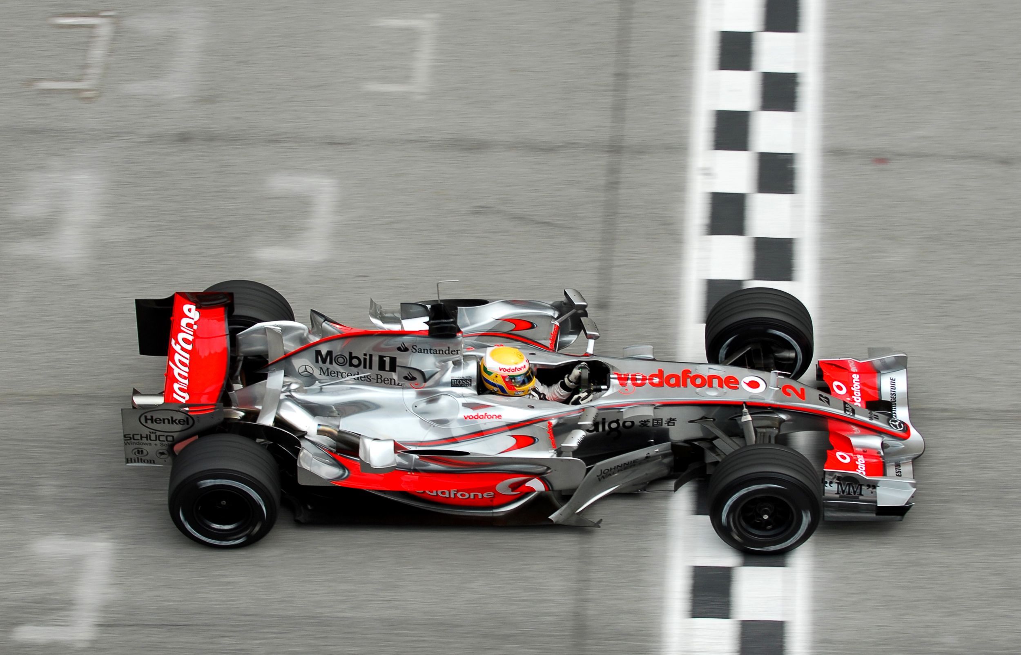
SUMMARY
Notes:
1. It's automatically multiplexed over HTTP/2
2. Data efficient
3. Limits the number of connections
4. Provides mechanism to save the battery by offloading the connection to a proxy

Slide 36


Slide 37

Connect ☺
LinkedIn: https://goo.gl/CRRJ2Y
Mail: martin.c@sbtech.com
Github: https://github.com/mchaov

